Slide 1
Chapter 4
How to work with JavaScript objects, functions, and events

Slide 2
Objectives (part 1)
Applied
Given the specifications for a JavaScript application that requires only the skills that you’ve learned so far, code, test, and debug the application.
Knowledge
Distinguish between these objects: window, document, Textbox, Number, Date, and String.
Describe the way Number and String objects are created.
Describe these methods of the window object: parseInt() and parseFloat().
Describe these methods of the document object: querySelector(), querySelectorAll(), and write().
Describe these methods and properties of a Textbox object: focus(), select(), value, and disabled.

Slide 3
Objectives (part 2)
Describe the toFixed() method of a Number object.
Describe the way Date objects are created.
Describe these methods of a Date object: toDateString(), getFullYear(), getDate(), and getMonth().
Describe the length property of a string and these methods of a string: indexOf(), substr(), substring(), toLowerCase(), and toUpperCase().
Describe the creation and use of function declarations, function expressions, and arrow functions.
Distinguish between function expressions and arrow functions.
Distinguish between global scope, local scope, and block scope.

Slide 4
Objectives (part 3)
Describe how to create and attach event handlers, including how to attach an event handler to the DOMContentLoaded event of the document object.
Describe the currentTarget property and the preventDefault() method of the Event object.

Slide 5
Some of the host objects in a browser environment
Object Description
window Represents the open browser window. This is the global object for JavaScript.
document Represents the HTML document in the browser window. Allows you to work with the Document Object Model (DOM).
navigator Contains information about the browser.
history Contains the URLs that a user has visited in the browser.

Slide 6
Some of the JavaScript native objects
Object Description
Object The base object that all other JavaScript objects inherit.
Array An object that stores a collection of data.
Date An object that stores a date.
Function An object that stores a predefined collection of JavaScript statements.
Number A wrapper object for working with the primitive number data type.
String A wrapper object for working with the primitive string data type.
Boolean A wrapper object for working with the primitive boolean data type.
Math A utility object with static methods for working with numbers.

Slide 7
How a Number object wraps a primitive number
A statement that creates a number variable
const pi = 3.14159; // pi is a primitive number data type
A statement that uses a method of the Number object
alert(pi.toFixed(2)); // JavaScript converts pi to a Number
// object so it can call its toFixed()
// method

Slide 8
Terms related to objects
object
property
method
host object
native object
wrapper object
utility object
Notes:
Host objects are part of the environment that JavaScript runs in.
Native (or built-in) objects are provided by the JavaScript language itself.
A wrapper object is one that contains another object or data type and provides properties and methods for working with it.
A utility objects is a collection of useful properties and methods, often grouped together based on common functionality, like doing math.

Slide 9
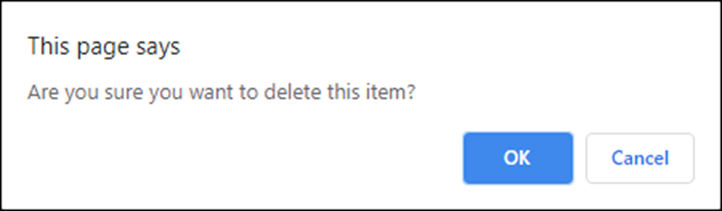
Another method of the window object that displays a dialog box
confirm(string)
How to use a dialog box to confirm an operation
const confirmDelete =
confirm("Are you sure you want to delete this item?");
if (confirmDelete) {
// code that deletes the item
}
The dialog box that’s displayed

Slide 10
Global functions for parsing numbers
parseInt(string)
parseFloat(string)
How to convert strings to numbers
let entryA = prompt("Enter any value", 12345.6789);
entryA = parseInt(entryA); // entryA = 12345
let entryB = prompt("Enter any value", 12345.6789);
entryB = parseFloat(entryB); // entryB = 12345.6789
Notes:
As per the current JavaScript standard these are global functions.
https://developer.mozilla.org/en-US/docs/Web/JavaScript/Reference/Global_Objects

Slide 11
Three methods of the document object
querySelector(selector)
querySelectorAll(selector)
write(string)
Notes:
querySelector - Returns the first HTML element that matches the selector that’s passed to it. The parameter is a string that must contain a valid CSS selector.
querySelectorAll - Returns all the HTML elements that match the selector that’s passed to it. The parameter is a string that must contain a valid CSS selector.
write - Writes the string parameter into the document.

Slide 12
Common ways to code selectors (part 1)
Selecting by element id
// returns the object for the HTML element
// whose id is "rate"
const rate = document.querySelector("#rate");
Selecting by element type
// returns an array of objects for all the <a> elements
// in the document
const links = document.querySelectorAll("a");
Selecting by a class
// returns an array of objects for all the elements
// assigned to the error class
const errors = document.querySelectorAll(".error");

Slide 13
Common ways to code selectors (part 2)
Using a descendant selector
// returns an array of all the h2 elements that are
// descendants of the element whose id is "faqs".
const h2s = document.querySelectorAll("#faqs h2");
Using a combination of selectors
// returns an array of all the div elements assigned
// to the closed class
const minus = document.querySelectorAll("div.closed");
Using multiple selectors
// returns an array of elements specified by two
// descendant selectors
const elements =
document.querySelectorAll("#faqs h2, div p");

Slide 14
How to write a line of HTML into the document
document.write("<b>Welcome to our website!</b>");

Slide 15
HTML tags that define two text boxes
<input type="text" id="first_name">
<input type="text" id="sales_amount">

Slide 16
Some methods and properties of text boxes
Methods
focus()
select()
Properties
value
disabled
A method of the Number object
toFixed(digits)

Slide 17
How to use the value property to get the
current value from a text box
Without chaining
let firstName = document.querySelector("#first_name");
firstName = firstName.value;
With chaining
const firstName =
document.querySelector("#first_name").value;
Notes:
Prefer consts and chaining.

Slide 18
How to use the parseFloat() method to get a number value from a text box
Without chaining
let salesAmt = document.querySelector("#sales_amount");
salesAmt = salesAmt.value;
salesAmt = parseFloat(salesAmt);
With chaining
const salesAmt = parseFloat(
document.querySelector("#sales_amount").value
);

Slide 19
Other examples of chaining
const salesAmt = parseFloat(
document.querySelector("#sales_amount").value
).toFixed(2);
document.querySelector("#first_name").value = "";
document.querySelector("#first_name").focus();

Slide 20
How to create a JavaScript object
The syntax for creating an object
const variableName = new ObjectType();
A statement that creates a Date object
const today = new Date();

Slide 21
Some methods of the Date object
toDateString()
getFullYear()
getDate()
getMonth()
Examples that use a Date object
const today = new Date();
alert( today.toDateString() );
alert( today.getFullYear() );
alert( today.getDate() );
alert( today.getMonth() );

Slide 22
Some properties and methods of the String object
One property
length
A few of the methods
indexOf(search, position)
substr(start, length)
substring(start, stop)
toLowerCase()
toUpperCase()
Examples that use a String object
const name = "Grace Hopper";
const nameUpper = name.toUpperCase();
const nameLength = name.length; // nameLength = 12
const index = name.indexOf(" "); // index = 5
const firstName = name.substr(0, index);

Slide 23
Terms related to specific objects
global object
document object
Textbox object
Number object
method/function chaining
Date object
String object
constructor

Slide 24
The syntax for a function declaration
function functionName (parameters) {
// statements that run when the function is executed
}

Slide 25
A function declaration with no parameters that doesn’t return a value
function showYear() {
const today = new Date();
alert( "The year is " + today.getFullYear() );
}
How to call the function
showYear();

Slide 26
A function declaration with one parameter that returns a DOM element
function $(selector) {
return document.querySelector(selector);
}
How to call the function
const email1 = $("#email_1").value;
Notes:
Please don't do this :(

Slide 27
A function declaration with two parameters that returns a value
function calculateTax(subtotal, taxRate) {
const tax = subtotal * taxRate;
return tax.toFixed(2);
}
How to call the function
const subtotal = 85.00;
const taxRate = 0.05;
const salesTax = calculateTax(subtotal, taxRate);
alert(salesTax); // displays 4.25

Slide 28
The syntax for a function expression
const constantName = function (parameters) {
// statements that run when the function is executed
};

Slide 29
A function expression with no parameters that doesn’t return a value
const showYear = function () {
const today = new Date();
alert( "The year is " + today.getFullYear() );
};
How to call the function
showYear();

Slide 30
A function expression with one parameter that returns a DOM element
const $ = function (selector) {
return document.querySelector(selector);
};
How to call the function
const email1 = $("#email_1").value;
Notes:
Please don't do this :(

Slide 31
A function expression with two parameters that returns a value
const calculateTax = function(subtotal, taxRate) {
const tax = subtotal * taxRate;
return tax.toFixed(2);
};
How to call the function
const subtotal = 85.00;
cont taxRate = 0.05;
// call the function
const salesTax = calculateTax(subtotal, taxRate);
alert(salesTax); // displays 4.25

Slide 32
The syntax for an arrow function
const constantName = (parameters) => {
// statements that run when the function is executed
};
The code for a function expression
const calculateTax = function (subtotal, taxRate) {
const tax = subtotal * taxRate;
return tax.toFixed(2);
};
The code rewritten as an arrow function
const calculateTax = (subtotal, taxRate) => {
const tax = subtotal * taxRate;
return tax.toFixed(2);
};

Slide 33
An arrow function with one parameter
const calculateTax = subtotal => {
const tax = subtotal * 0.074;
return tax.toFixed(2);
};
An arrow function with one parameter that executes one statement
const calculateTax = subtotal =>
(subtotal * 0.074).toFixed(2);
An arrow function with no parameters that executes one statement
const getCurrentUrl = () => document.location.href;
How to call an arrow function
const url = getCurrentUrl();

Slide 34
Terms related to functions
function
calling (invoking) a function
function declaration
parameter
argument
passing parameters
return statement
hoisted
function expression
arrow function
arrow operator

Slide 35
Two global variables
var taxRate = 0.074; // adds taxRate property to window object
let tax = 0; // doesn't add anything to window object
alert(window.taxRate); // displays 0.074
alert(window.tax); // displays undefined
A function that uses the global variables
const calculateTax = subtotal => {
tax = subtotal * taxRate;
tax = tax.toFixed(2);
};
calculateTax(100);
alert(tax); // displays 7.4

Slide 36
A function that uses local variables and constants
const calculateTax = (subtotal, taxRate) => {
const tax = subtotal * taxRate;
return tax.toFixed(2);
};
const tax = calculateTax(100, 0.074);
alert(tax);
A function with two loops
function local() {
for(var i = 0; i < 5; i++) {...} // function scope
alert(i); // i still in scope - displays 5
for(let j = 0; j < 5; j++) {...} // block scope
alert(j); // j not in scope - ReferenceError
}

Slide 37
Terms related to scope
scope
global variable
global constant
local variable
local constant
function scope
block scope

Slide 38
Common events
Object Event
window load
document DOMContentLoaded
control focus
blur
change
select
element click
dblclick
mouseover
mousein
mouseout

Slide 39
The syntax for the addEventListener() method
eventTarget.addEventListener("eventName", eventHandlerFunction);
An event handler named joinList
const joinList = () => {
alert("The statements for the function go here")
};
How to attach the event handler to the click event of a button
$("#submit_button").addEventListener("click", joinList);
How to attach the event handler to the double-click event of a text box
$("#text_box_1").addEventListener("dblclick", joinList);
The syntax for the removeEventListener() method
eventTarget.removeEventListener("eventName", eventHandlerFunction);

Slide 40
Code that handles the DOMContentLoaded event
Using a named function as the event handler
const showMessage = () => {
alert("The DOM is ready!");
};
document.addEventListener("DOMContentLoaded", showMessage);
Using an anonymous function as the event handler
document.addEventListener("DOMContentLoaded", () => {
alert("The DOM is ready!");
});

Slide 41
Code that attaches a click event handler for a button when the DOM is loaded
Using a named function as the event handler
const processEntries = () => {
// code that processes entries
};
document.addEventListener("DOMContentLoaded", () => {
$("#calculate").addEventListener("click", processEntries);
});
Using an anonymous function as the event handler
document.addEventListener("DOMContentLoaded", () => {
$("#calculate").addEventListener("click", () => {
// code that processes entries
});
});

Slide 42
A property and a method of the Event object
Property
currentTarget
Method
preventDefault()

Slide 43
Common HTML elements that have default actions for the click event
Element Default action for the click event
<a> Load the page or image in the href attribute.
<input> Submit the form if the type attribute is set to submit.
<input> Reset the form if the type attribute is set to reset.
<button> Submit the form if the type attribute is set to submit.
<button> Reset the form if the type attribute is set to reset.

Slide 44
An HTML form with a text box and a submit button
<form action="join.html" method="get">
<input type="text" id="email_1" name="email_1">
<input type="submit" id="join_list" value="Join List">
</form>

Slide 45
An event handler for the click event of the submit button
const joinList = evt => {
if (document.querySelector("#email_1").value == "") {
// notify user of error
alert("Email is required.");
// don't allow form to be submitted
evt.preventDefault();
}
};
document.addEventListener("DOMContentLoaded", () => {
$("#join_list").addEventListener("click", joinList);
});

Slide 46
Terms related to events
event
event handler
attach an event handler
anonymous function
default action for an event

Slide 47
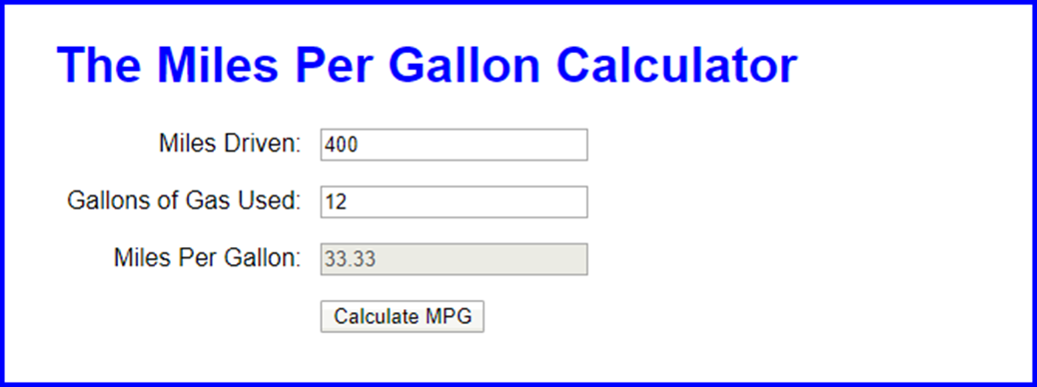
The Miles Per Gallon application in a browser

Slide 48
The HTML for the MPG application (part 1)
<!DOCTYPE html>
<html>
<head>
<meta name="viewport"
content="width=device-width, initial-scale=1">
<title>Miles Per Gallon Calculator</title>
<link rel="stylesheet" href="mpg.css">
</head>
<body>
<main>
<h1>The Miles Per Gallon Calculator</h1>
<div>
<label for="miles">Miles Driven:</label>
<input type="text" id="miles">
</div>
<div>
<label for="gallons">Gallons of Gas Used:
</label>
<input type="text" id="gallons">
</div>

Slide 49
The HTML for the MPG application (part 2)
<div>
<label for="mpg">Miles Per Gallon:</label>
<input type="text" id="mpg" disabled>
</div>
<div>
<label>&nbsp;</label>
<input type="button" id="calculate"
value="Calculate MPG">
</div>
</main>
<script src="mpg.js"></script>
</body>
</html>

Slide 50
The JavaScript for the MPG application (part 1)
"use strict";
const $ = selector => document.querySelector(selector);
const getErrorMsg = lbl =>
`${lbl} must be a valid number greater than zero.`;
const focusAndSelect = selector => {
const elem = $(selector);
elem.focus();
elem.select();
};
const processEntries = () => {
const miles = parseFloat($("#miles").value);
const gallons = parseFloat($("#gallons").value);
if (isNaN(miles) || miles <= 0) {
alert(getErrorMsg("Miles driven"));
focusAndSelect("#miles");

Slide 51
The JavaScript for the MPG application (part 2)
} else if (isNaN(gallons) || gallons <= 0) {
alert(getErrorMsg("Gallons of gas used"));
focusAndSelect("#gallons");
} else {
$("#mpg").value = (miles / gallons).toFixed(2);
}
};
document.addEventListener("DOMContentLoaded", () => {
$("#calculate").addEventListener(
"click", processEntries);
$("#miles").focus();
});

Slide 52
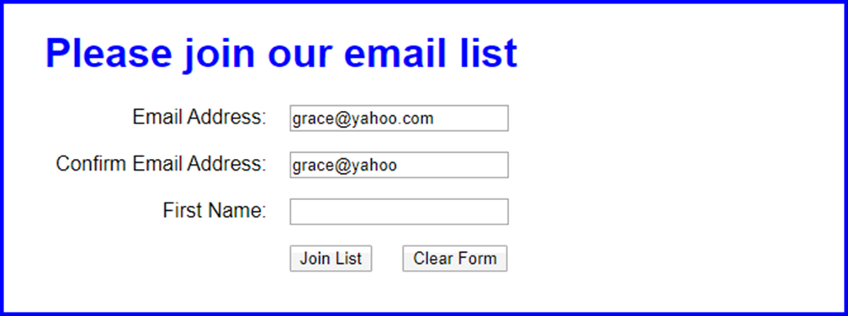
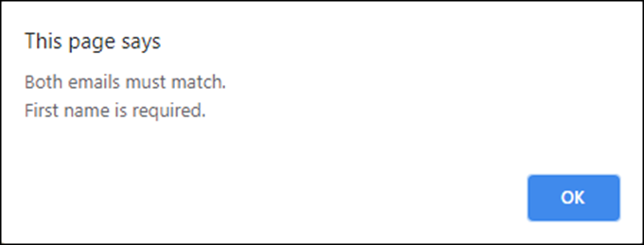
The Email List application in a web browser

Slide 53
The HTML for the Email List application (part 1)
<!DOCTYPE html>
<html>
<head>
<meta name="viewport"
content="width=device-width, initial-scale=1">
<title>Join Email List</title>
<link rel="stylesheet" href="email_list.css">
</head>
<body>
<main>
<h1>Please join our email list</h1>
<form id="email_form" name="email_form"
action="join.html" method="get">
<div>
<label for="email_1">Email Address:
</label>
<input type="text" id="email_1"
name="email_1">
</div>
<div>
<label for="email_2">Re-enter Email Address:
</label>
<input type="text" id="email_2" name="email_2">
</div>

Slide 54
The HTML for the Email List application (part 2)
<div>
<label for="first_name">First Name:</label>
<input type="text" id="first_name"
name="first_name">
</div>
<div>
<label>&nbsp;</label>
<input type="submit" id="join_list"
value="Join our List">
<input type="button" id="clear_form"
value="Clear form">
</div>
</form>
</main>
<script src="email_list.js"></script>
</body>
</html>

Slide 55
The JavaScript for the Email List app (part 1)
const $ = selector => document.querySelector(selector);
document.addEventListener("DOMContentLoaded", () => {
$("#join_list").addEventListener("click", evt => {
// get values user entered in textboxes
const email1 = $("#email_1").value;
const email2 = $("#email_2").value;
const firstName = $("#first_name").value;
// create an error message and set it to an empty string
let errorMessage = "";
// check user entries – add to error message if invalid
if (email1 == "") {
errorMessage += "First email is required.\n";
}
if (email2 == "") {
errorMessage += "Second email is required.\n";
}
if (email1 != email2) {
errorMessage += "Both emails must match.\n";
}

Slide 56
The JavaScript for the Email List app (part 2)
if (firstName == "") {
errorMessage += "First name is required.\n";
}
// prevent form submission if there’s an error message
if (errorMessage != "") {
alert(errorMessage);
evt.preventDefault();
}
});
$("#clear_form").addEventListener("click", () => {
$("#email_1").value = "";
$("#email_2").value = "";
$("#first_name").value = "";
$("#email_1").focus();
});
$("#email_1").focus();
});

